Slide 1

Deconvolutional Networks
Matthew D. Zeiler Dilip Krishnan, Graham W. Taylor Rob Fergus
Dept. of Computer Science, Courant Institute, New York University

Slide 2

Matt Zeiler

Slide 3
Overview
Unsupervised learning of mid and high-level image representations
Feature hierarchy built from alternating layers of:
Convolutional sparse coding (Deconvolution)
Max pooling
Application to object recognition

Slide 4
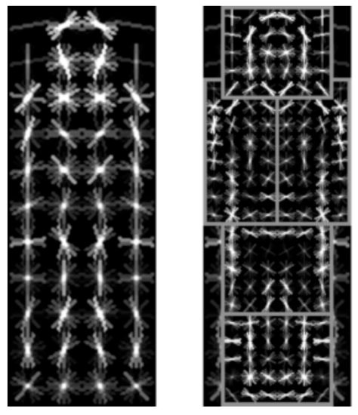
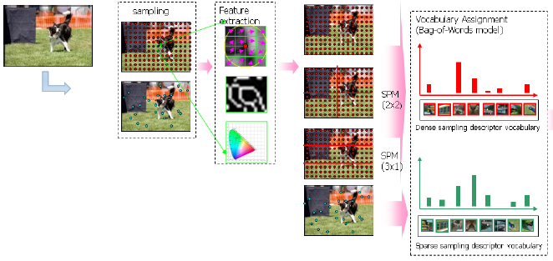

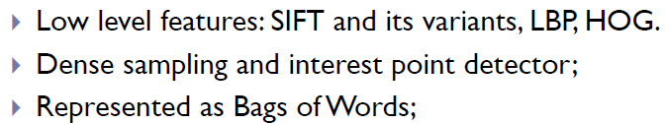
Motivation
Good representations are key to many tasks in vision
Edge-based representations are basis of many models
SIFT [Lowe’04], HOG [Dalal & Triggs ’05] & others
Felzenszwalb, Girshick, McAllester and Ramanan, PAMI 2007
Yan & Huang (Winner of PASCAL 2010 classification competition)

Slide 5

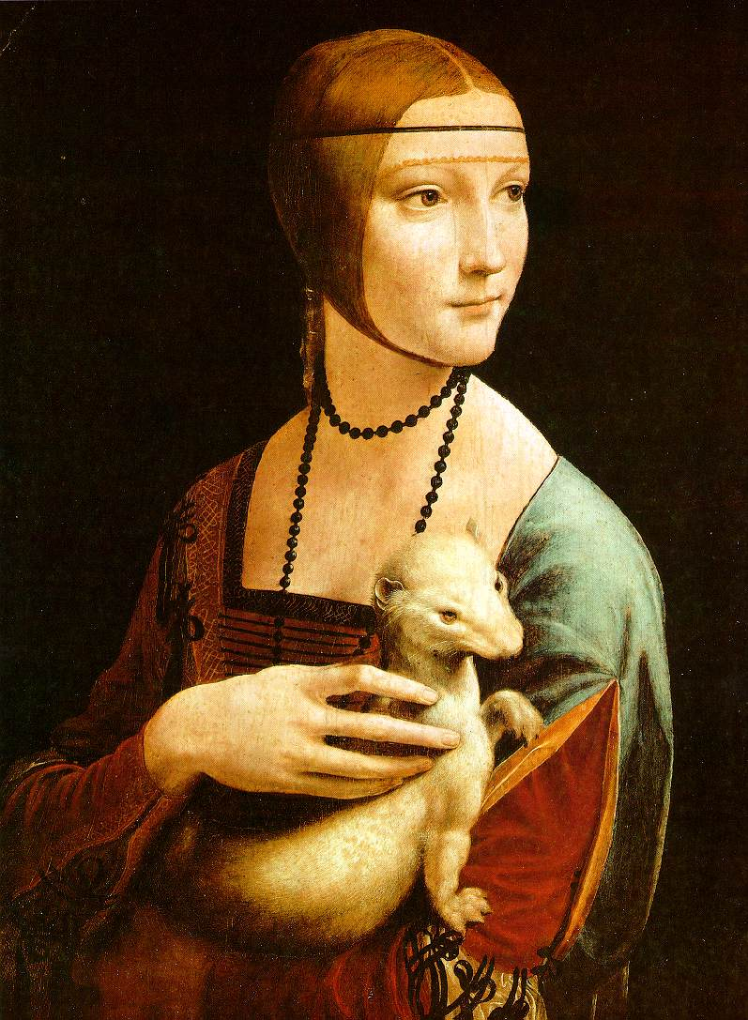
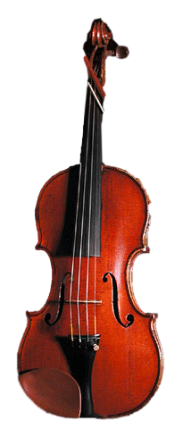
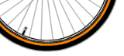
Beyond Edges?
Mid-level cues
Continuation
Parallelism
Junctions
Corners
“Tokens” from Vision by D.Marr
High-level object parts:

Slide 6
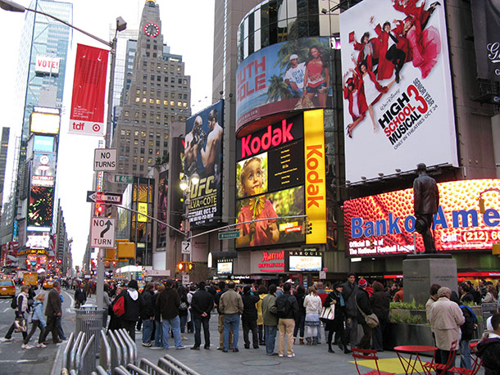
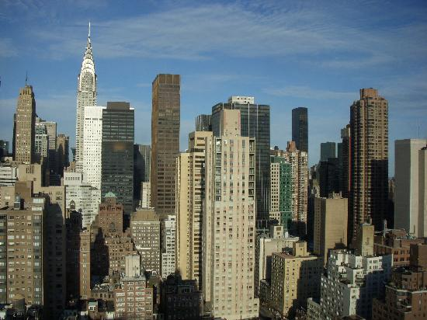




Two Challenges
Grouping mechanism
Want edge structures to group into more complex forms
But hard to define explicit rules
Invariance to local distortions
Corners, T-junctions, parallel lines etc. can look quite different

Slide 7
Talk Overview
Single layer
Convolutional Sparse Coding
Max Pooling
Multiple layers
Multi-layer inference
Filter learning
Comparison to related methods
Experiments

Slide 8
Talk Overview
Single layer
Convolutional Sparse Coding
Max Pooling
Multiple layers
Multi-layer inference
Filter learning
Comparison to related methods
Experiments

Slide 9

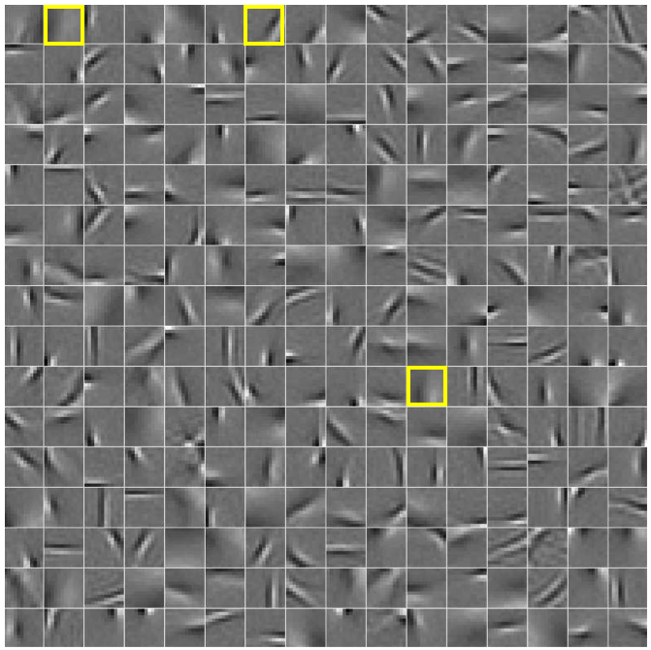
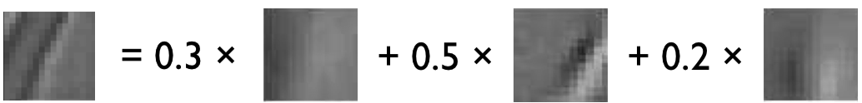
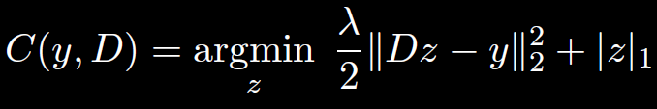
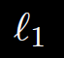
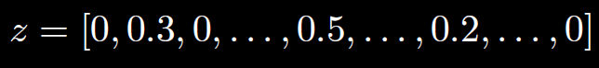
Recap: Sparse Coding (Patch-based)
Over-complete linear decomposition of input using dictionary
Input
Dictionary
regularization yields solutions with few non-zero elements
Output is sparse vector:

Slide 10
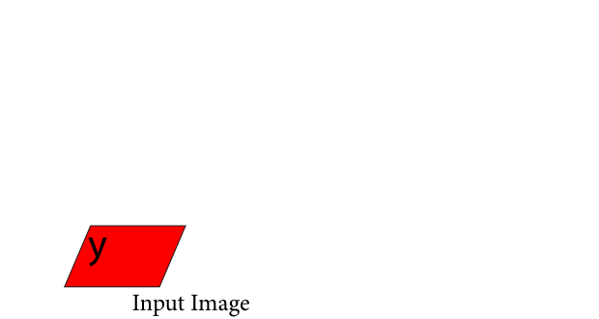
Single Deconvolutional Layer
Convolutional form of sparse coding
Notes:
Image, filters

Slide 11
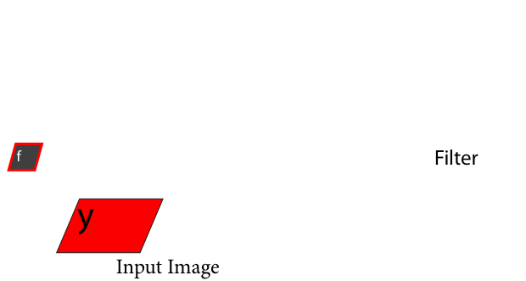
Single Deconvolutional Layer
Notes:
Add filters label in middle

Slide 12
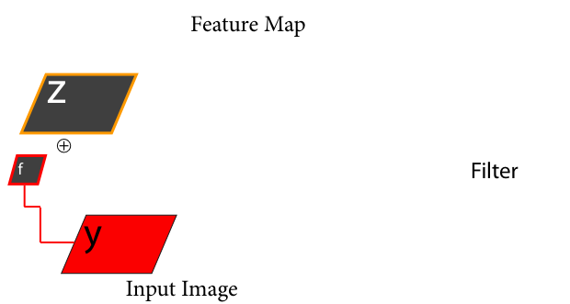
Single Deconvolutional Layer

Slide 13
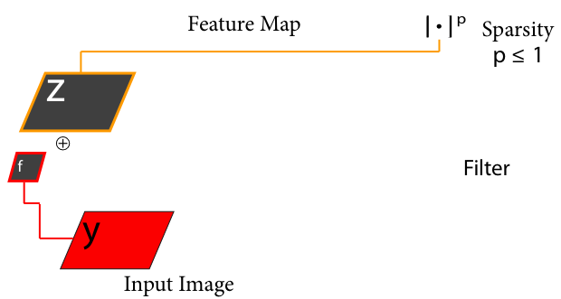
Single Deconvolutional Layer
1

Slide 14
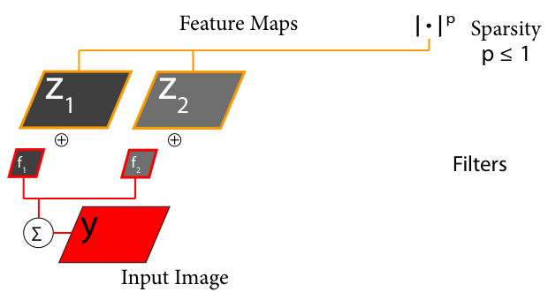
Single Deconvolutional Layer
1

Slide 15
Single Deconvolutional Layer
1

Slide 16
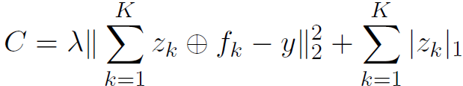
Single Deconvolutional Layer
1
Top-down Decomposition

Slide 17
Single Deconvolutional Layer
1

Slide 18
Single Deconvolutional Layer
1

Slide 19
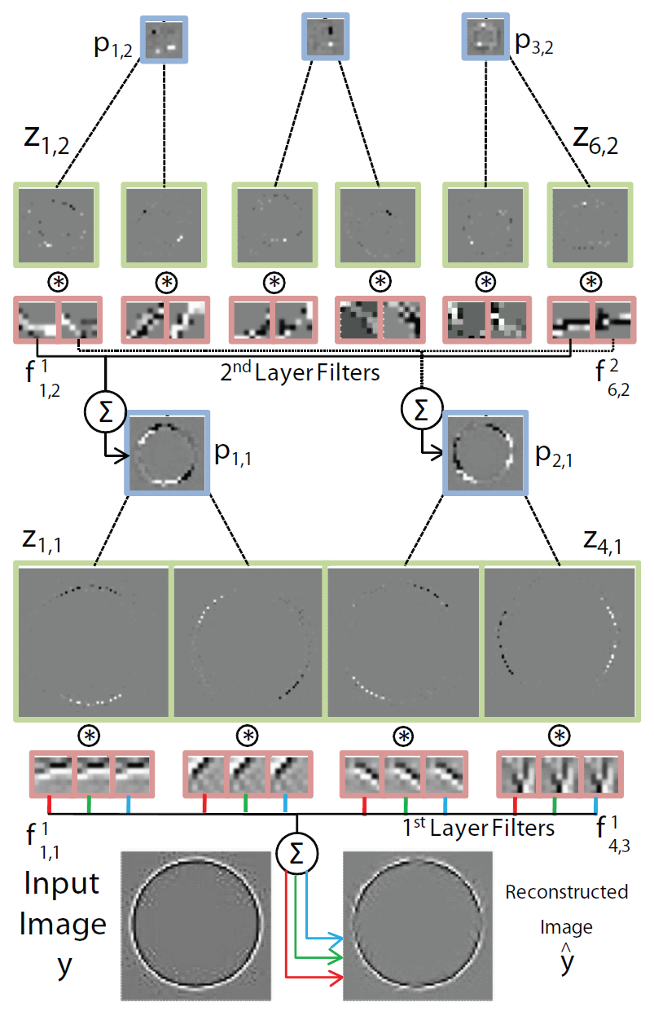
Toy Example
Feature maps
Filters

Slide 20

Objective for Single Layer
min z:
= Input, = Feature maps, = Filters
Simplify Notation::
Filters are parameters of model (shared across all images)
Feature maps are latent variables (specific to an image)

Slide 21
Inference for Single Layer
Objective:
Known: = Input, = Filter weights. Solve for : = Feature maps
Iterative Shrinkage & Thresholding Algorithm (ISTA) Alternate:
1) Gradient step:
2) Shrinkage (per element):
Only parameter is ( can be automatically selected)
Notes:
Shrinkage is per element.

Slide 22
Effect of Sparsity
Introduces local competition in feature maps
Explaining away
Implicit grouping mechanism
Filters capture common structures
Thus only a single dot in feature maps is needed to reconstruct large structures

Slide 23
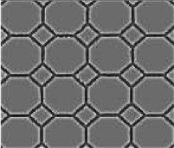
Local Inhibition/Explaining Away
How many different line segments (filters) are needed to represent this image?

Slide 24
Talk Overview
Single layer
Convolutional Sparse Coding
Max Pooling
Multiple layers
Multi-layer inference
Filter learning
Comparison to related methods
Experiments

Slide 25
Reversible Max Pooling
Max Locations
“Switches”
Pooled Feature Maps
Pooling
Unpooling
Feature Map
Reconstructed Feature Map

Slide 26
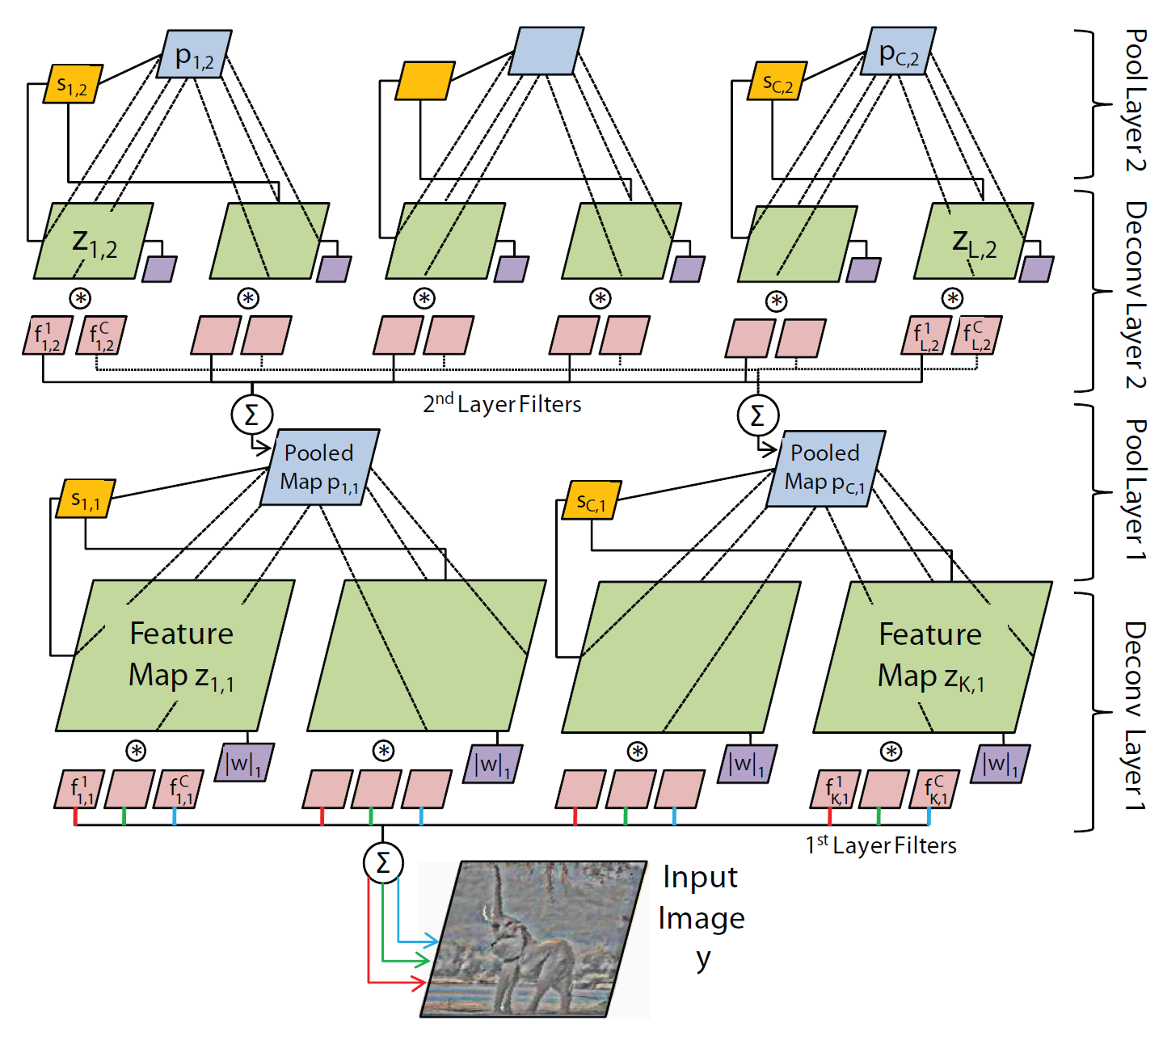
3D Max Pooling
Pool within & between feature maps
Take absolute max value (& preserve sign)
Record locations of max in switches

Slide 27
3D Max Pooling
Pool within & between feature maps:
Pooling/unpooling is linear, given max locations:
Pooling: Unpooling:
Notes:
Pooling provides invariances to where the activations occur in the feature maps.
Storing the indices allows us to recover these locations during reconstruction providing a pathway directly back to the input which involves unpooling then convolutions.
Sparsity: The unpooling operation enforces group sparsity within each pooling region (amongst maps as well in groups) since during the unpooling at most one element can be on.

Slide 28
Role of Switches
Permit reconstruction path back to input
Record position of local max
Important for multi-layer inference
Set during inference of each layer
Held fixed for subsequent layers’ inference
Provide invariance:
Single feature map

Slide 29
Overall Architecture (1 layer)

Slide 30
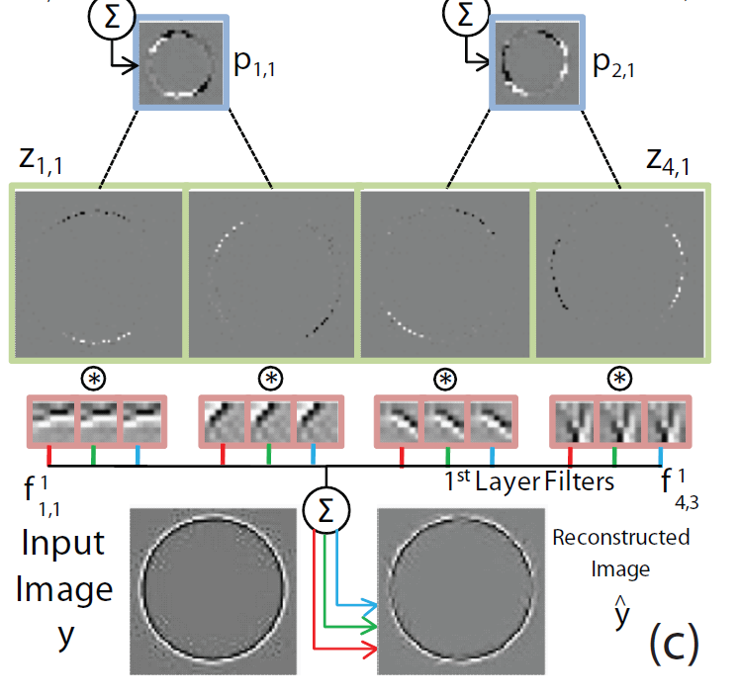
Toy Example
Pooled maps
Feature maps
Filters

Slide 31
Effect of Pooling
Reduces size of feature maps
So we can have more of them in layers above
Pooled maps are dense
Ready to be decomposed by sparse coding of layer above
Benefits of 3D Pooling
Added Competition
Local L0 Sparsity
AND/OR Effect

Slide 32
Talk Overview
Single layer
Convolutional Sparse Coding
Max Pooling
Multiple layers
Multi-layer inference
Filter learning
Comparison to related methods
Experiments

Slide 33
Stacking the Layers
Take pooled maps as input to next deconvolution/pooling layer
Learning & inference is layer-by-layer
Objective is reconstruction error
Key point: with respect to input image
Constraint of using filters in layers below
Sparsity & pooling make model non-linear
No sigmoid-type non-linearities

Slide 34
Overall Architecture (2 layers)

Slide 35
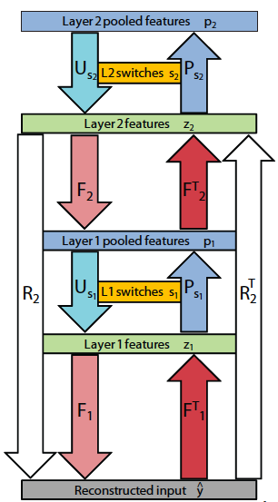
Multi-layer Inference
Consider layer 2 inference:
Want to minimize reconstruction error of input image , subject to sparsity.
Don’t care about reconstructing layers below
ISTA:
Update :
Shrink :
Update switches, :
No explicit non-linearities between layers
But still get very non-linear behavior

Slide 36
Filter Learning
Objective:
Known: = Input, = Feature maps. Solve for : = Filter weights
Update Filters with Conjugate Gradients:
For Layer 1:
For higher layers:
Obtain gradient by reconstructing down to image and projecting error back up to current layer
Normalize filters to be unit length

Slide 37
Overall Algorithm
For Layer 1 to L: % Train each layer in turn
For Epoch 1 to E: % Loops through dataset
For Image 1 to N: % Loop over images
For ISTA_step 1 to T: % ISTA iterations
Reconstruct % Gradient
Compute error % Gradient
Propagate error % Gradient
Gradient step % Gradient
Skrink % Shrinkage
Pool/Update Switches % Update Switches
Update filters % Learning, via linear CG system

Slide 38
2nd layer pooled maps
2nd layer feature maps
2nd layer filters
1st layer pooled maps
1st layer feature maps
1st layer filters
Toy Input

Slide 39
Talk Overview
Single layer
Convolutional Sparse Coding
Max Pooling
Multiple layers
Multi-layer inference
Filter learning
Comparison to related methods
Experiments

Slide 40
Related Work
Convolutional Sparse Coding
Zeiler, Krishnan, Taylor & Fergus [CVPR ’10]
Kavukcuoglu, Sermanet, Boureau, Gregor, Mathieu & LeCun [NIPS ’10]
Chen, Spario, Dunson & Carin [JMLR submitted]
Only 2 layer models
Deep Learning
Hinton & Salakhutdinov [Science ‘06]
Ranzato, Poultney, Chopra & LeCun [NIPS ‘06]
Bengio, Lamblin, Popovici & Larochelle [NIPS ‘05]
Vincent, Larochelle, Bengio & Manzagol [ICML ‘08]
Lee, Grosse, Ranganth & Ng [ICML ‘09]
Jarrett, Kavukcuoglu, Ranzato & LeCun [ICCV ‘09]
Ranzato, Mnih, Hinton [CVPR’11]
Reconstruct layer below, not input
Deep Boltzmann Machines
Salakhutdinov & Hinton [AIStats ’09]

Slide 41
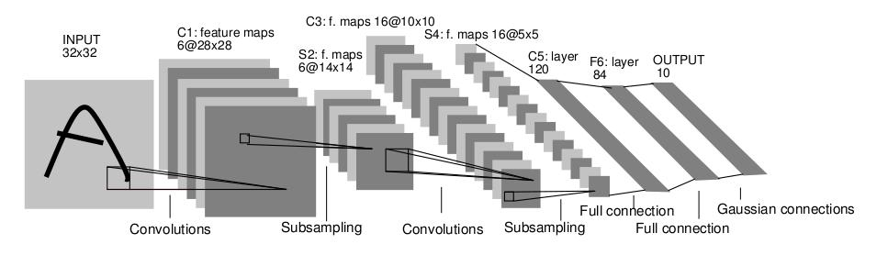
Comparison: Convolutional Nets
LeCun et al. 1989
Convolutional Networks
Bottom-up filtering with convolutions in image space.
Trained supervised requiring labeled data.
Deconvolutional Networks
Top-down decomposition with convolutions in feature space.
Non-trivial unsupervised optimization procedure involving sparsity.

Slide 42
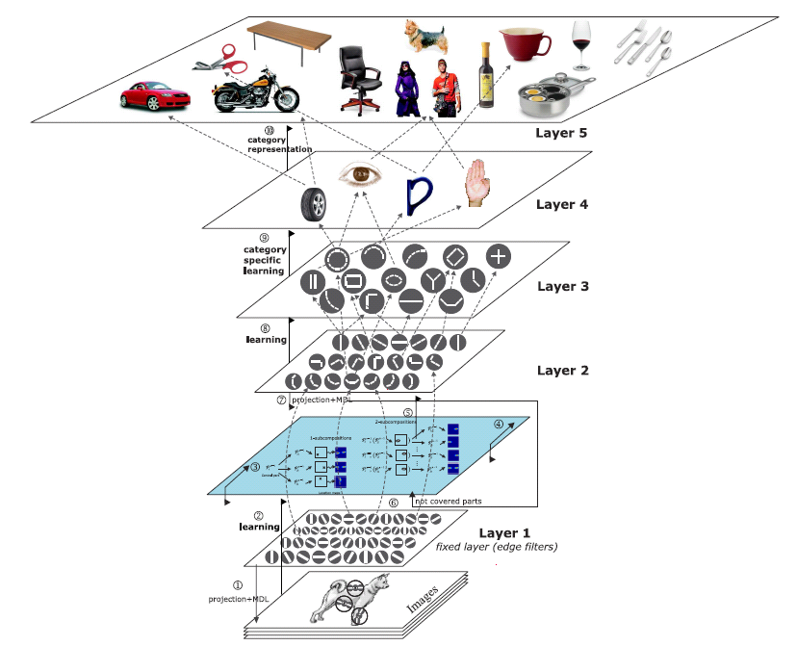
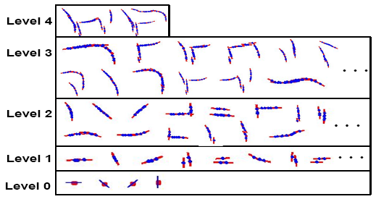

Related Work
Hierarchical vision models
Zhu & Mumford [F&T ‘06]
Tu & Zhu [IJCV ‘06]
Serre, Wolf & Poggio [CVPR ‘05]
Fidler & Leonardis [CVPR ’07]
Jin & Geman [CVPR ’06]
Zhu & Yuille [NIPS ’07]

Slide 43
Talk Overview
Single layer
Convolutional Sparse Coding
Max Pooling
Multiple layers
Multi-layer inference
Filter learning
Comparison to related methods
Experiments

Slide 44
Training Details
3060 training images from Caltech 101
30 images/class, 102 classes (Caltech 101 training set)
Resized/padded to 150x150 grayscale
Subtractive & divisive contrast normalization
Unsupervised
6 hrs total training time (Matlab, 6 core CPU)

Slide 45
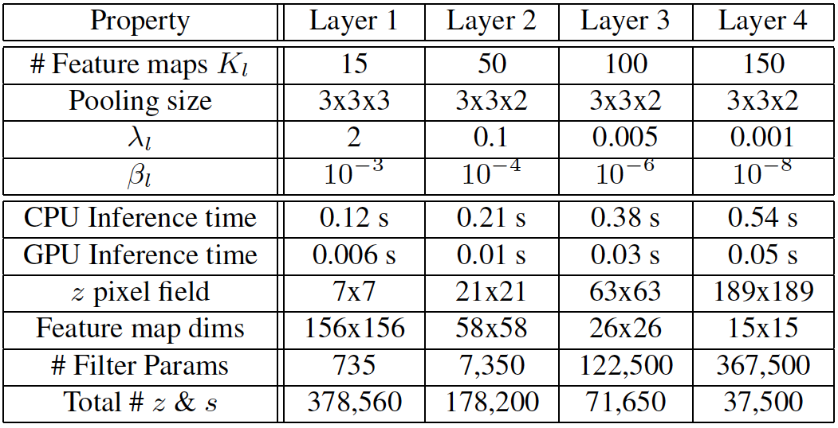
Model Parameters/Statistics
7x7 filters at all layers

Slide 46
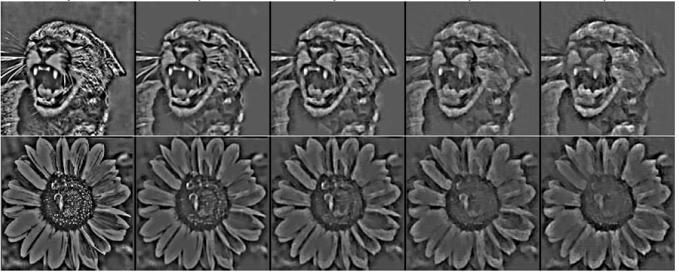
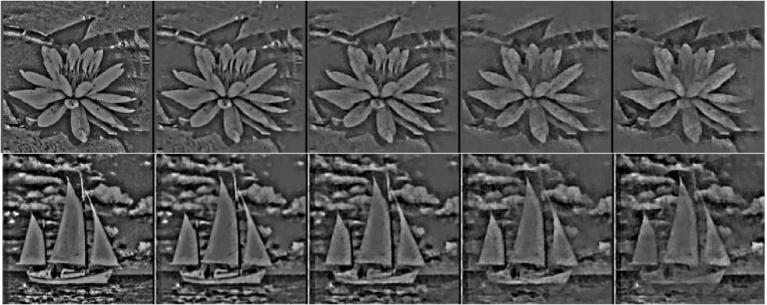
Model Reconstructions

Slide 47
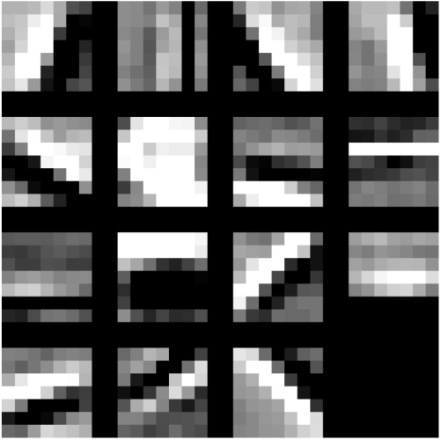
Layer 1 Filters
15 filters/feature maps, showing max for each map

Slide 48
Visualization of Filters from Higher Layers
Raw coefficients are difficult to interpret
Don’t show effect of switches
Feature Map
Take max activation from feature map associated with each filter
Project back to input image (pixel space)
Use switches in lower layers peculiar to that activation
....
Filters
Lower Layers
Input Image
Training Images

Slide 49
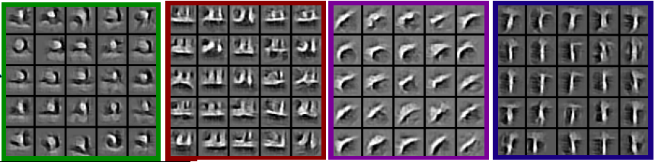
Layer 2 Filters
50 filters/feature maps, showing max for each map projected down to image

Slide 50
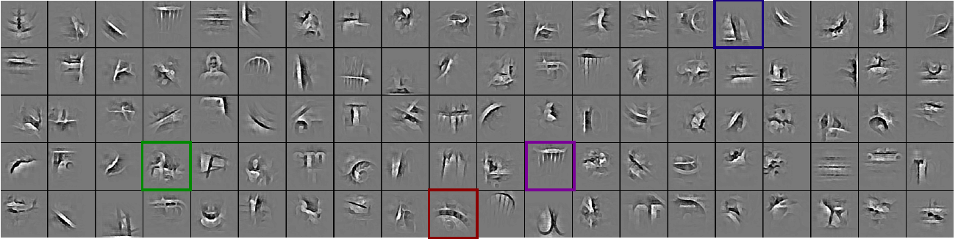
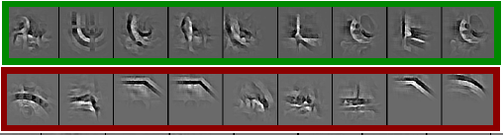
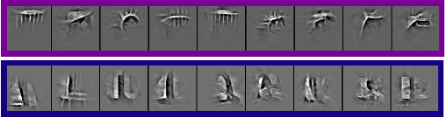
Layer 3 filters
100 filters/feature maps, showing max for each map

Slide 51
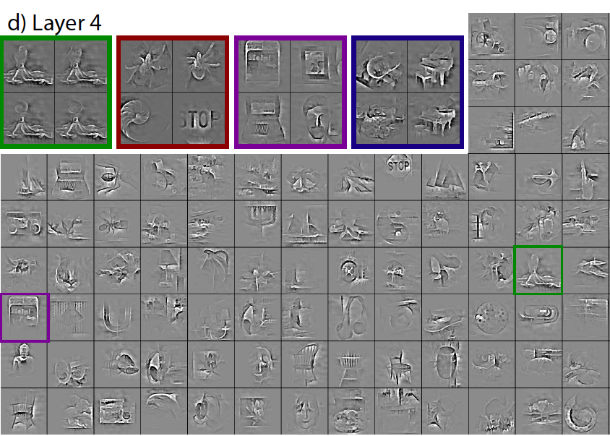
Layer 4 filters
150 in total; receptive field is entire image

Slide 52
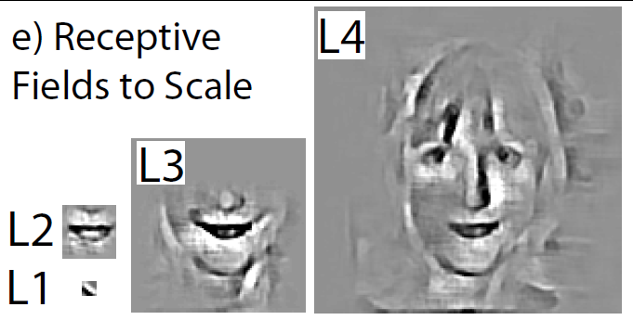
Relative Size of Receptive Fields
(to scale)

Slide 53
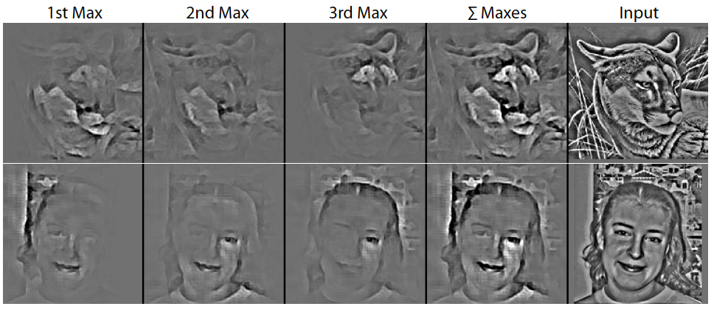
Largest 3 activations at top layer
Pixel space visualization from individual top layer maxes.

Slide 54
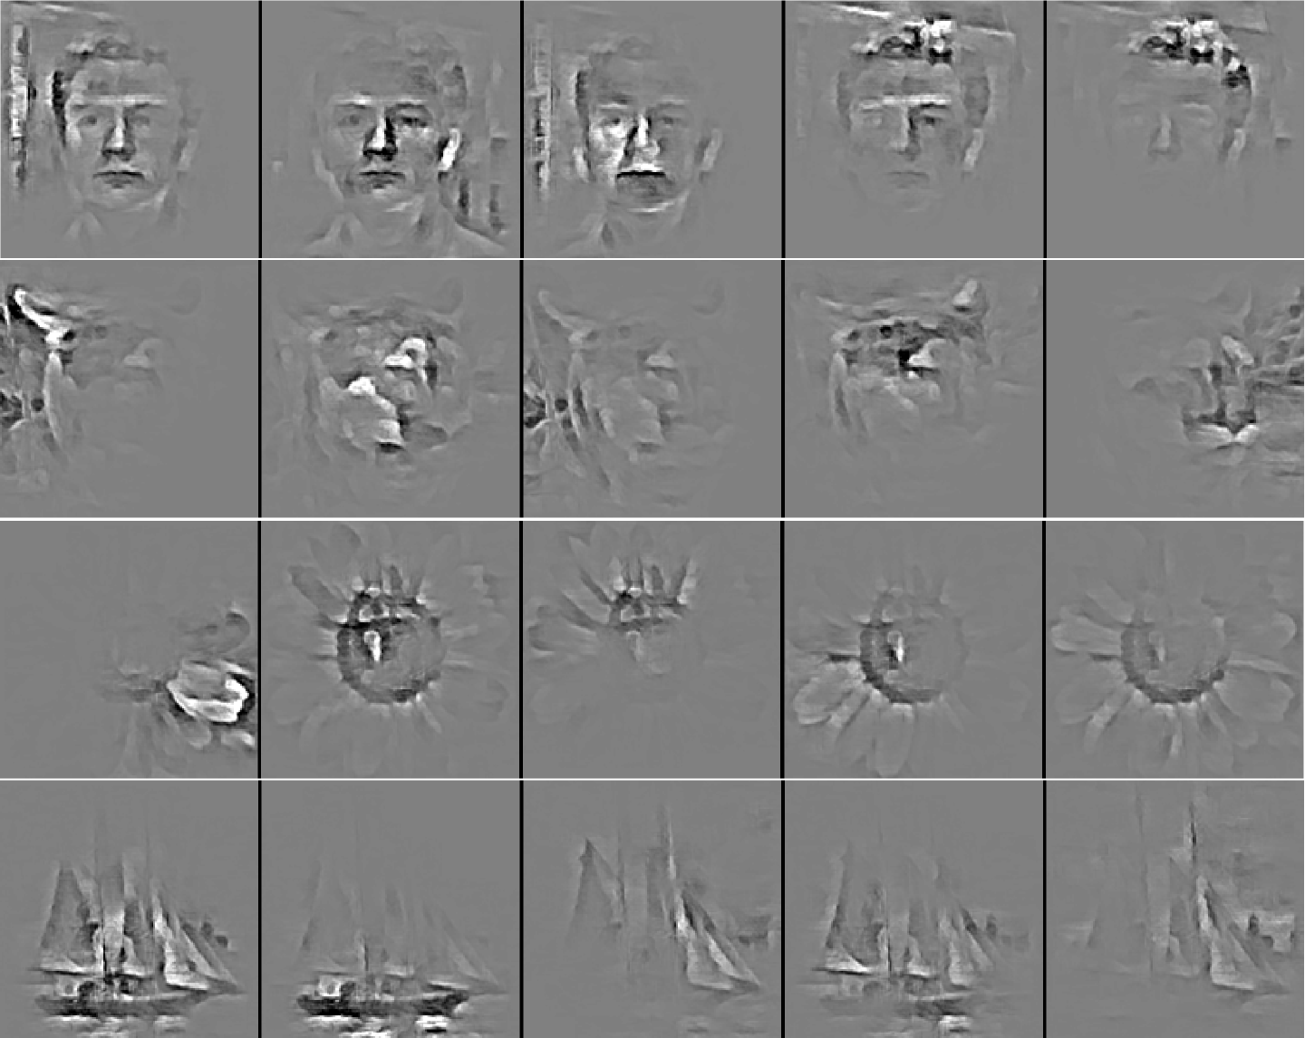
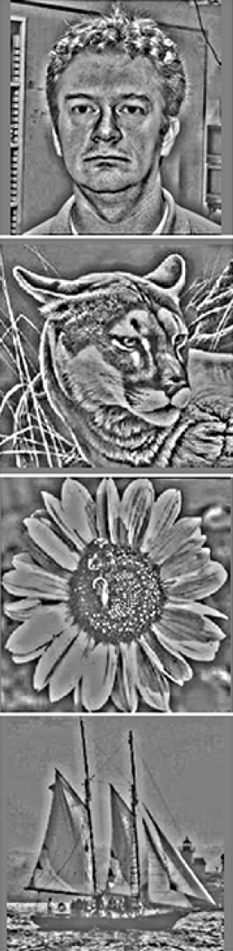
Largest 5 activations at top layer
Max 1 Max 2 Max 3 Max 4 Max 5
Input Image

Slide 55
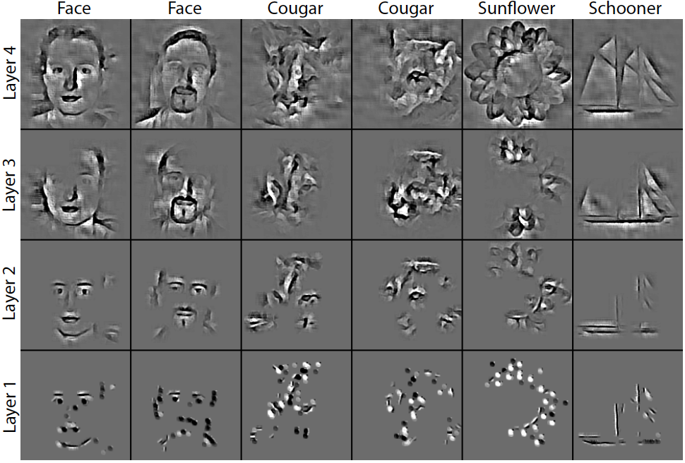
Top-down Decomposition
Pixel visualizations of strongest features activated from top-down reconstruction from single max in top layer.

Slide 56
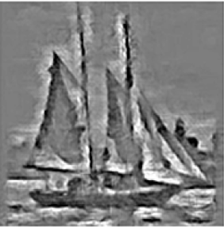
Application to Object Recognition
Use Spatial Pyramid Matching of Lazebnik et al. [CVPR’06]
Can’t directly use our top layer activations
Activations depend on lower layer switch settings
For each image:
Separately project top 50 max activations down
Take projections at 1st layer (analogous to SIFT)
Sum the resulting 50 pyramid histograms
Feature Maps
Feature Maps
Feature Maps
SIFT
Spatial Pyramid
Histogram
Histogram Intersection Kernel SVM
Vector Quantization
Feature Vectors
Instead of coding:
We separately code:

Slide 57
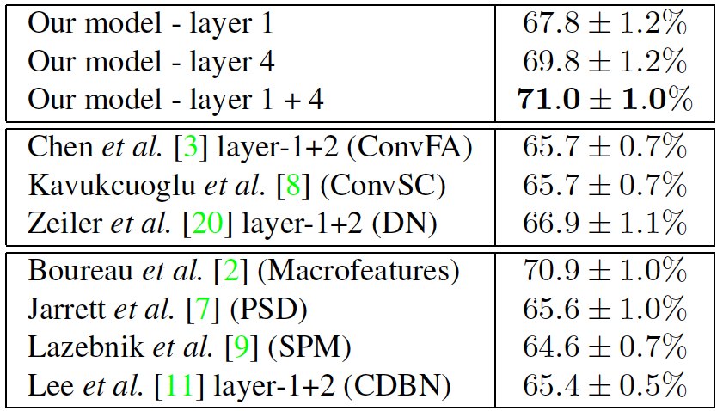
Classification Results: Caltech 101
Use 1st layer activations as input to Spatial Pyramid Matching (SPM) of Lazebnik et al. [CVPR’06]
Convolutional Sparse Coding
Other approaches using SPM with Hard quantization

Slide 58
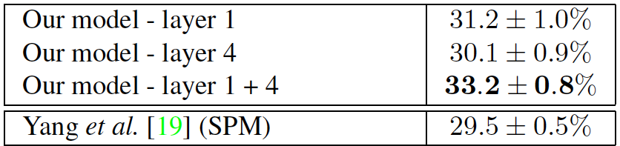
Classification Results: Caltech 256
Use 1st layer activations as input to Spatial Pyramid Matching (SPM) of Lazebnik et al. [CVPR’06]
Other approaches using SPM with Hard quantization

Slide 59
Classification Results: Transfer Learning
Training filters on one dataset, classify in another.
Classifying Caltech 101
Using Caltech 101 Filters: 71.0 ± 1.0 %
Using Caltech 256 Filters: 70.5 ± 1.1 % (transfer)
Classifying Caltech 256
Using Caltech 256 Filters: 33.2 ± 0.8 %
Using Caltech 101 Filters: 33.9 ± 1. 1 % (transfer)

Slide 60
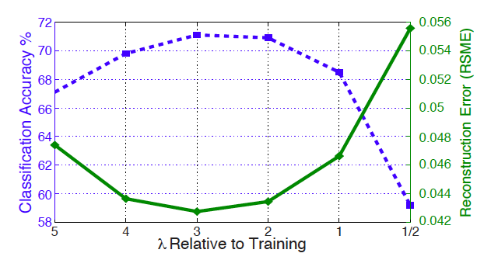
Classification/Reconstruction Relationship
Caltech 101 classification for varying lambda.

Slide 61
Effect of Sparsity
Explaining away, as induced by ISTA, helps performance
But direct feed-forward (0 ISTA iterations) works pretty well
cf. Rapid object categorization in humans (Thorpe et al.)

Slide 62
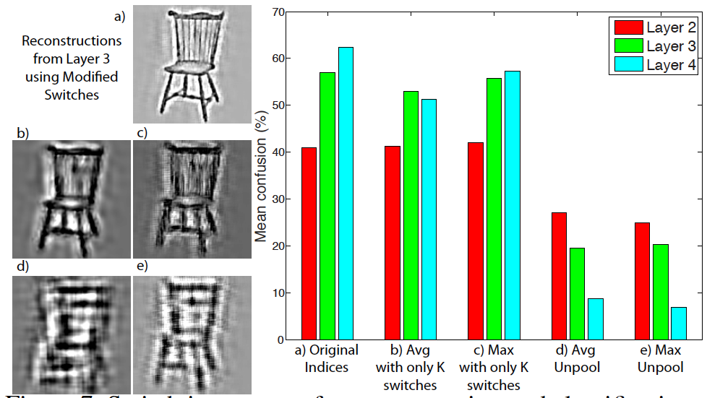
Analysis of Switch Settings
Recons. and classification with various unpooling.

Slide 63
Summary
Introduced multi-layer top-down model.
Non-linearity induced by sparsity & pooling switches, rather than explicit function.
Inference performed with quick ISTA iterations.
Tractable for large & deep models.
Obtains rich features, grouping and useful decompositions from 4-layer model.

Slide 65
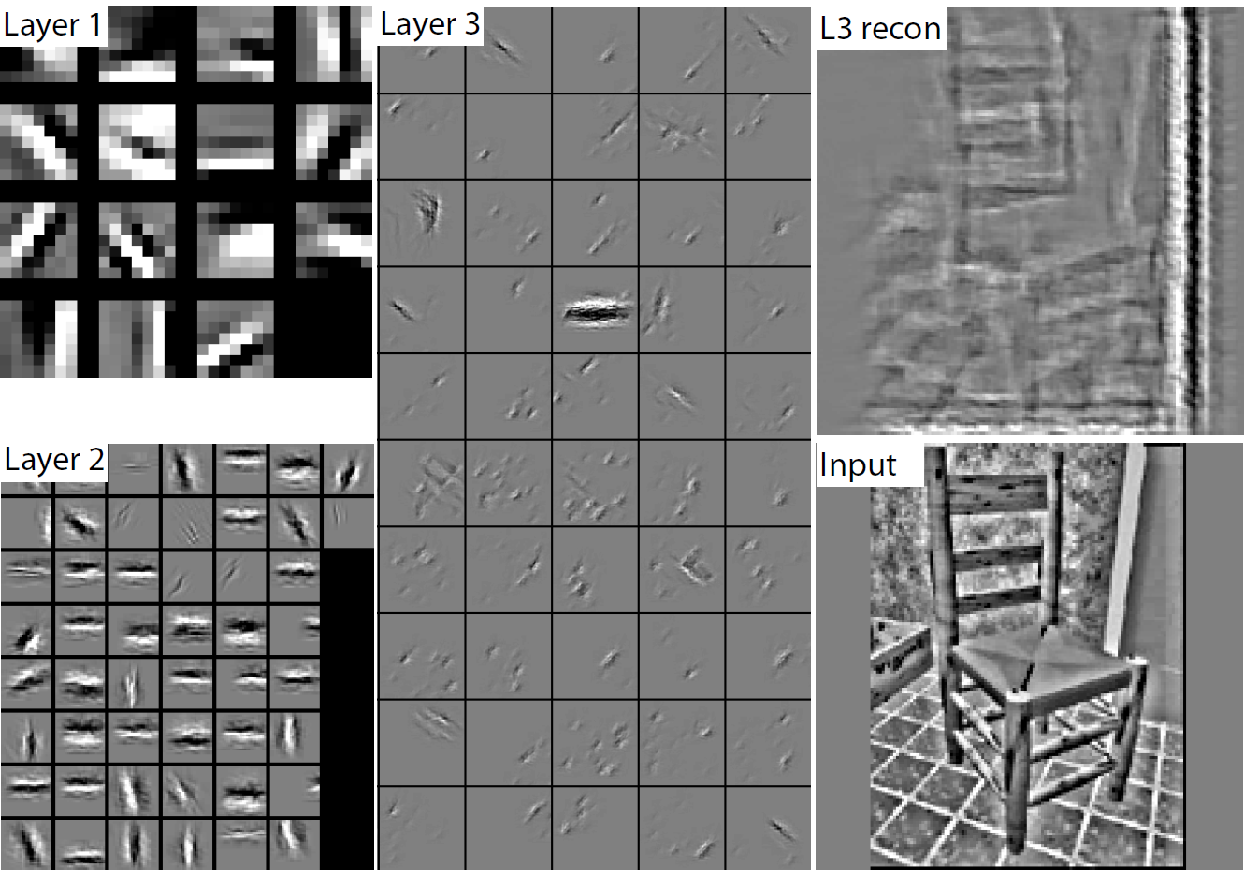
Model using layer-layer reconstruction

Slide 66
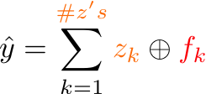
Single Deconvolutional Layer
1

Slide 67
Single Deconvolutional Layer
1

Slide 68
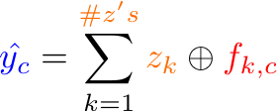
Single Deconvolutional Layer
1

Slide 69

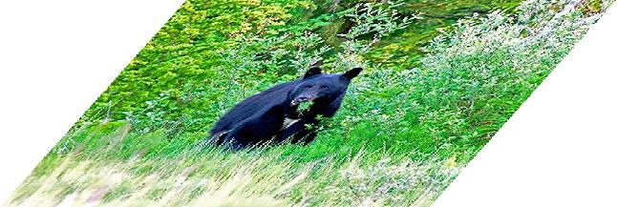
Context and Hierarchy in a Probabilistic Image Model Jin & Geman (2006)
e.g. animals, trees, rocks
e.g. contours, intermediate objects
e.g. linelets, curvelets, T-junctions
e.g. discontinuities, gradient
animal head instantiated by bear head
animal head instantiated by tiger head

Slide 70

A Hierarchical Compositional System for Rapid Object Detection Long Zhu, Alan L. Yuille, 2007.
Able to learn #parts at each level

Slide 71
Comparison: Convolutional Nets
LeCun et al. 1989
Convolutional Networks
Bottom-up filtering with convolutions in image space.
Trained supervised requiring labeled data.
Deconvolutional Networks
Top-down decomposition with convolutions in feature space.
Non-trivial unsupervised optimization procedure involving sparsity.

Slide 72
Learning a Compositional Hierarchy of Object Structure
Fidler & Leonardis, CVPR’07; Fidler, Boben & Leonardis, CVPR 2008
Parts model
The architecture
Learned parts

